Slide 1
POLYNOMIALS
Grade 9 – Chapter 2

Slide 2
Introduction
Constants : A symbol having a fixed numerical value is called a constant.
Variables : A symbol which may be assigned different numerical values is known as variable.
Algebraic expressions : A combination of constants and variables connected by some or all of the operations +, -, *,/ is known as algebraic expression.
Terms : The several parts of an algebraic expression separated by ‘+’ or ‘-‘ operations are called the terms of the expression.

Slide 3
Polynomial
Polynomial is an algebraic expression which includes constants, variables and exponents. It is the expression in which the variables have only positive integral powers.
Example
1. 4x³ + 3x² + x +3 is a polynomial in variable x.
2. 4x² + 3x⁻¹ - 4 is not a polynomial as it has negative power.
3. 3x^{3/2} + 2x – 3 is not a polynomial.

Slide 4
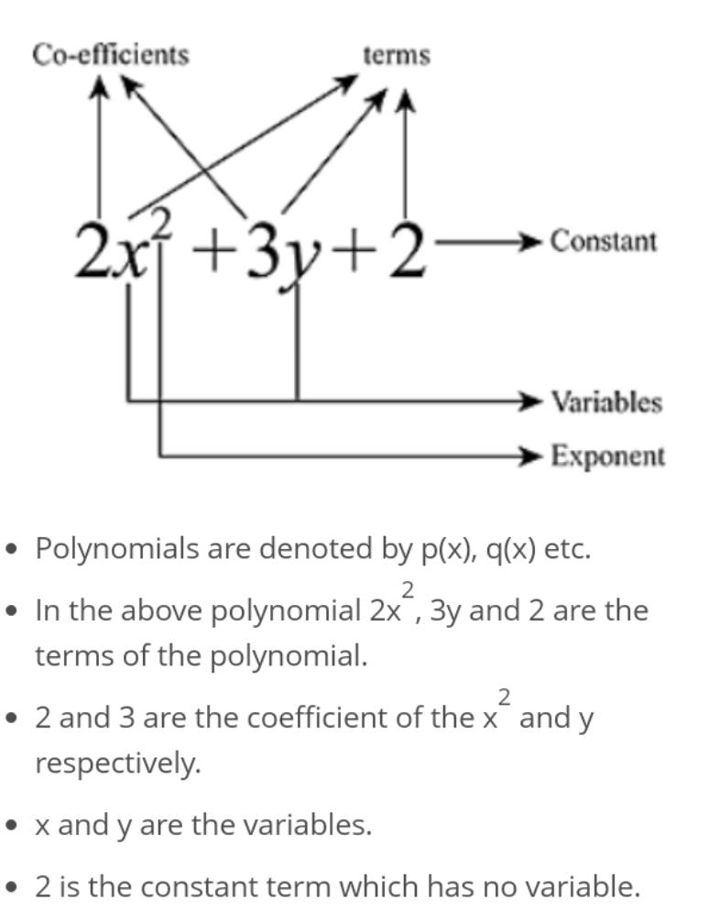

Slide 5
Polynomials in One Variable
If there is only one variable in the expression then this is called the polynomial in one variable.
Example
x³ + x – 4 is polynomial in variable x and is denoted by p(x).
r² + 2 is polynomial in variable r and is denoted by p(r).

Slide 6
What is the Degree of a Polynomial?
A polynomial’s degree is the highest or the greatest degree of a variable in a polynomial equation. The degree indicates the highest exponential power in the polynomial (ignoring the coefficients).
For Example: 6x⁴ + 2x³+ 3
The degree of the polynomial 6x⁴ + 2x³+ 3 is 4.
Let’s take another example: 3x⁸+ 4x³ + 9x + 1
The degree of the polynomial 3x⁸+ 4x³ + 9x + 1 is 8.

Slide 7
(a) In one variable: In case of a polynomial in one variable, the highest power of the variable is called the degree of the polynomial. e.g., √2 – y³ + y⁵ + 2y⁶ is a polynomial in y of degree 6. 6x + √3 is a polynomial in x of degree 1.
(b) In two or more variables: In case of a polynomial in more than one variable, the sum of the powers of the variables in each term is taken up and the highest sum so obtained is called the degree of the polynomial. e.g., 3x³ – 7x²y² + 8 is a polynomial in x and y of degree 4. 8a⁸b – 4ab + √2 is a polynomial in a and b of degree 9.

Slide 8
Note: The degree of a non-zero constant polynomial is ‘zero’. The degree of a zero polynomial is not defined.

Slide 9
Types of Polynomial
Monomial: Polynomials having only one term are called monomials (‘mono’ means ‘one’). e.g., µ⁴³, xz and – 2 are all monomials.
Binomial: Polynomials having only two terms are called binomials (‘bi’ means ‘two’). e.g., (x² + x), (y³⁰ + √2) and (5x²y + 6xz) are all binomials.
Trinomial: Polynomials having only three terms are called trinomials (‘tri’ means ‘three’). e.g., (x⁴ + x³ + √2), (µ⁴³ + µ⁷ + µ) and (8y – 5xy + 9xy²) are all trinomials.

Slide 10
Constant polynomial: A polynomial containing one term only, consisting of a constant is called a constant polynomial. e.g., -6, 4, , etc., are still constant polynomial. Generally, each real number is a constant polynomial.
Zero polynomial: A polynomial consisting of one term, namely zero only, is called a zero polynomial

Slide 11
Linear Polynomial: A polynomial of degree one is called a linear polynomial. e.g., x + √7 is a linear polynomial in x, y and z. √2 µ + 3 is a linear polynomial in µ.
Quadratic Polynomial: A polynomial of degree two is called a quadratic polynomial. e.g; xy + yz + zx is a quadratic polynomial in x, y and z. x² + 9x – is a quadratic polynomial in x.
Cubic Polynomial: A polynomial of degree three is called a cubic polynomial. e.g., ax³ + bx² + cx + d is a cubic polynomial in x and a, b, c, d are constants. 2y³ + 3 is a cubic polynomial in y. 9x²y + xy – 4 is a cubic polynomial in x and y.

Slide 12
For each of the following polynomials write down its degree:
(i) 1 + 3z
(ii) 1 + 3m + 5m² (iii) 4u + 5u³ + 17u⁵ + 7 (iv) a⁹ + 4a³ + 7a² + 10 (v) -11p + 7 (vi) m⁶ + 1
(vii) 2a² + 3a² + 4a (viii) 5a³b – 7a² + 11b²
(ix) 0
(x) 536

